Slide 1
Data Science
Unit-III
Stochastic Models Markov Processes & Chains, Classification of states
Source: Probability and Statistics by Krishna Gandhi

Slide 2
Stochastic Process
A stochastic process is a mathematical object that represents a collection of random variables. It's a probabilistic model for random quantities that evolve or space.
Here are some examples of stochastic processes:
The number of students waiting for a bus.
The time it takes for the nth student to reach the bus stop.

Slide 3
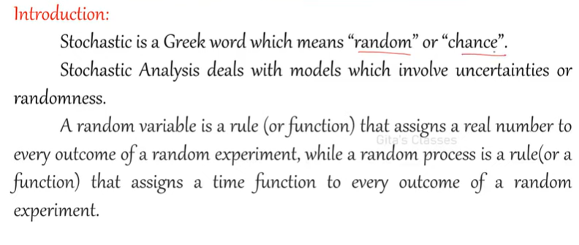
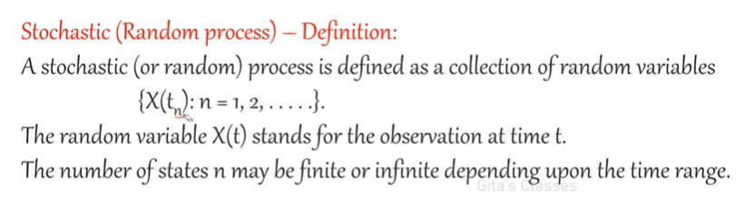
Introduction

Slide 4
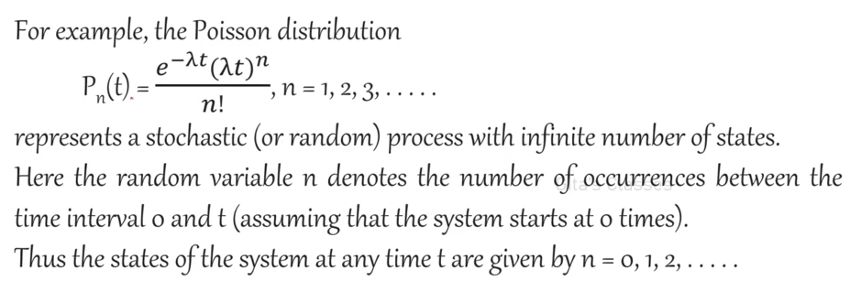
Introduction

Slide 5
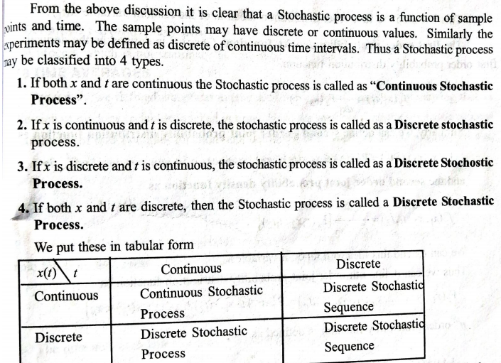
Classification of Stochastic Processes

Slide 6
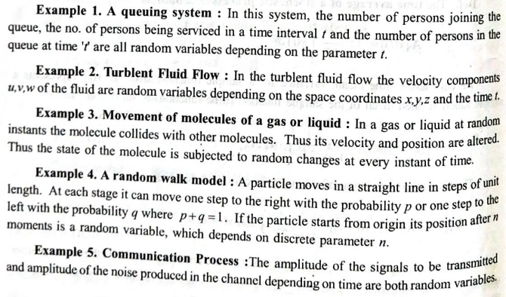
Examples of Stochastic Processes

Slide 7
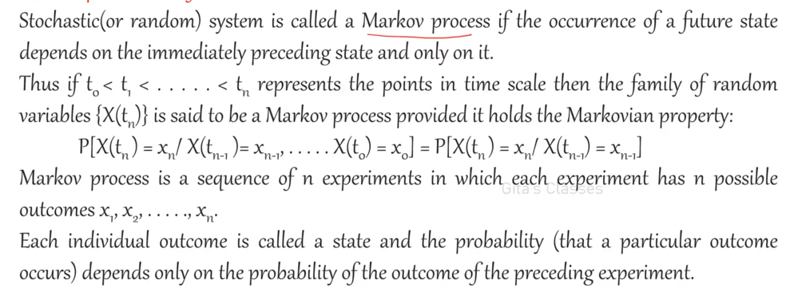
Markov process: Definition

Slide 8
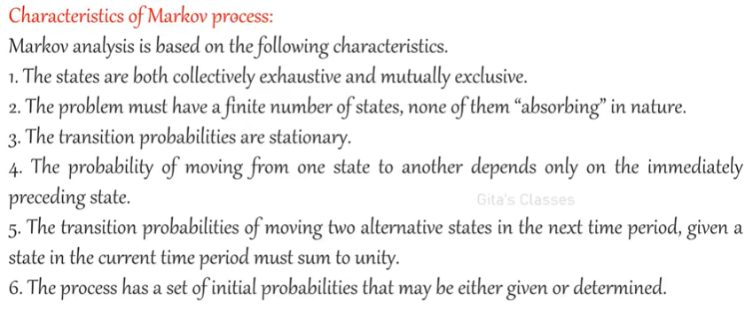
Characteristics of Markov Processes

Slide 9
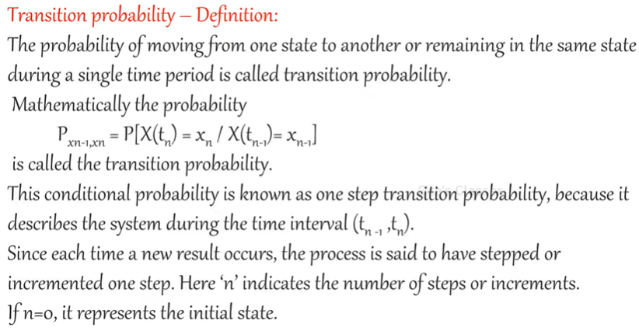
Transition probability

Slide 10
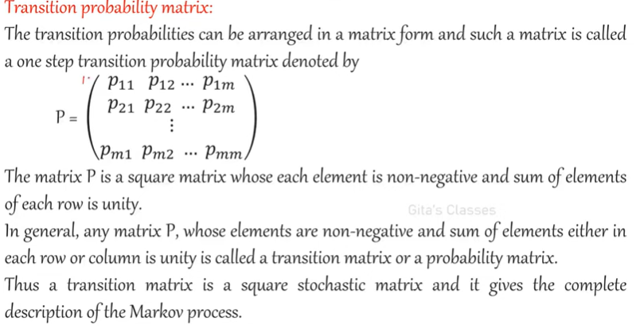
Transition probability Matrix

Slide 11
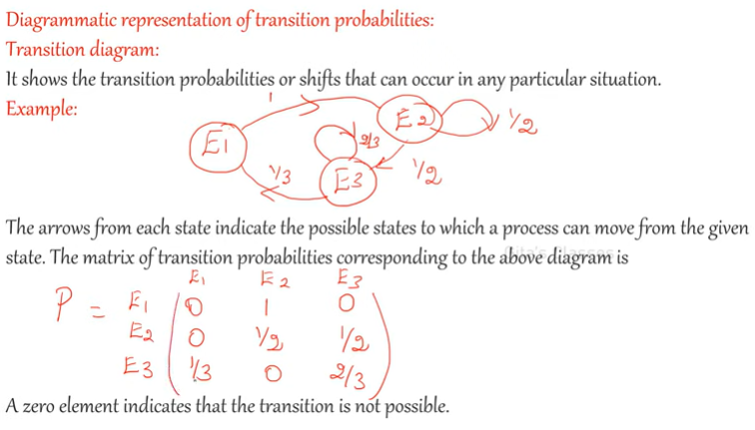
Transition probability Matrix

Slide 12
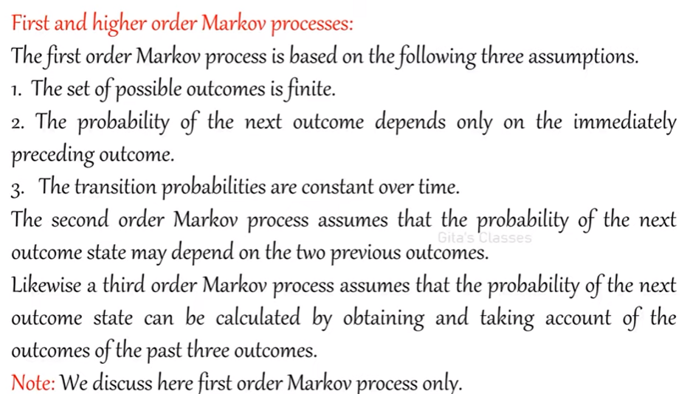
First order and Higher-order Markov chains

Slide 13
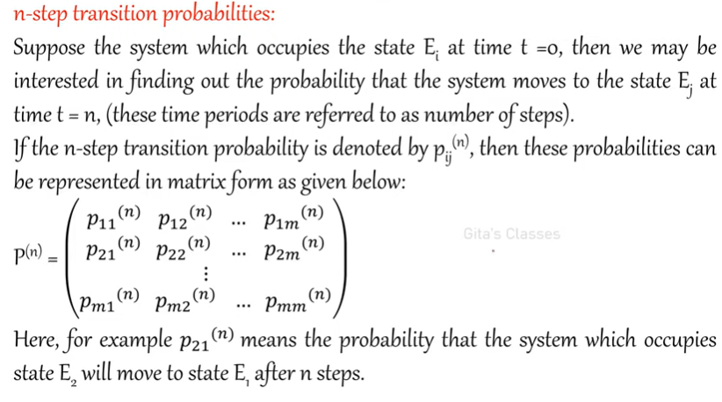
N-step Transition probabilities

Slide 14
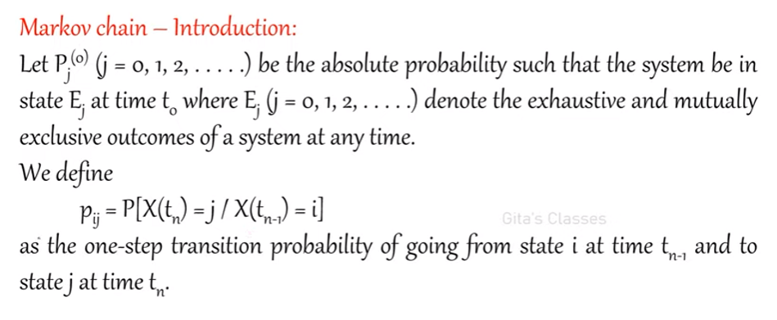
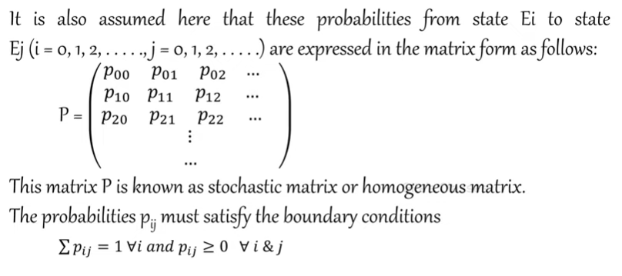
Markov Chain - Introduction

Slide 15
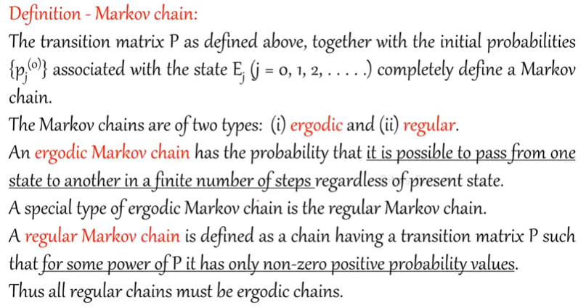
Markov chain

Slide 16
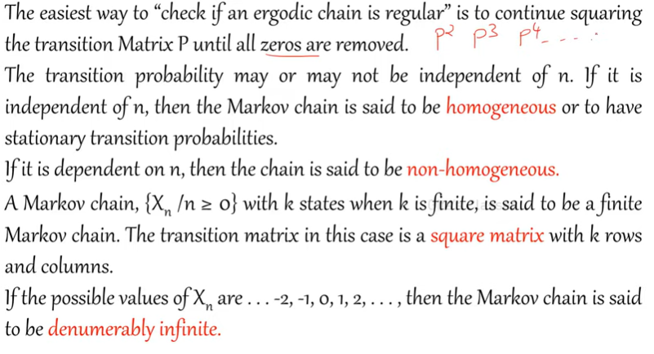
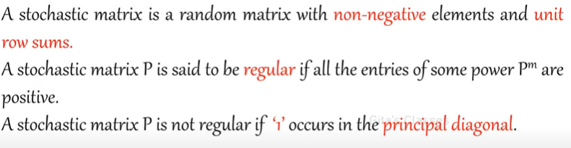
Markov chain

Slide 17
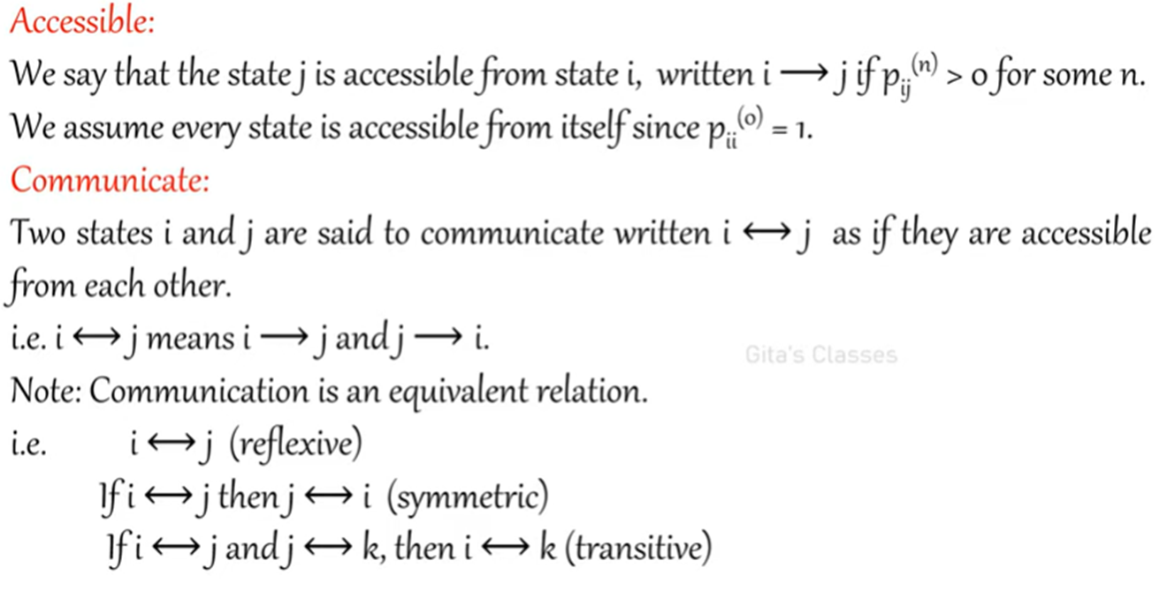
Markov chain

Slide 18
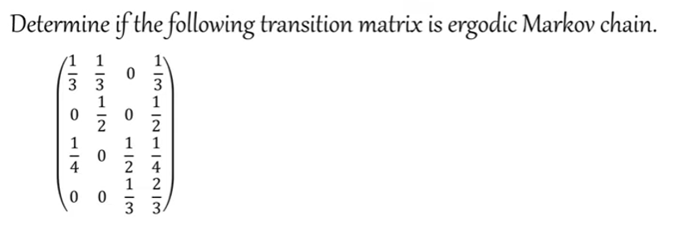
Examples
Ergodic: Every state must be reachable to all states.
Draw a transition diagram of the above
Check: Not ergodic

Slide 19
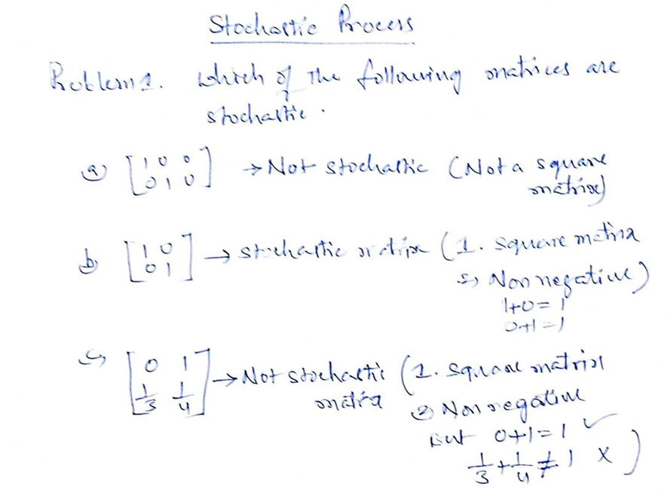
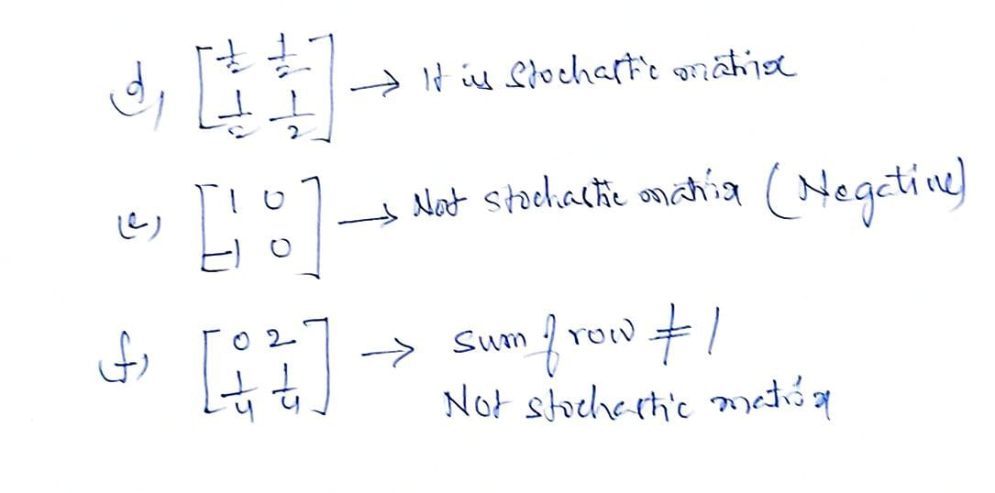

Slide 20
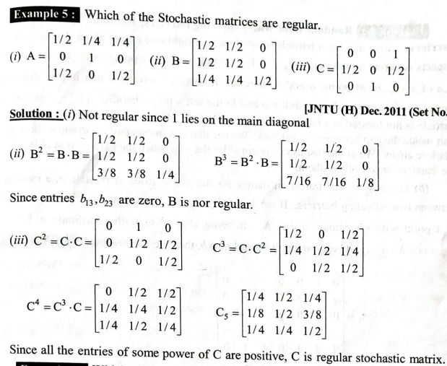
Example

Slide 21
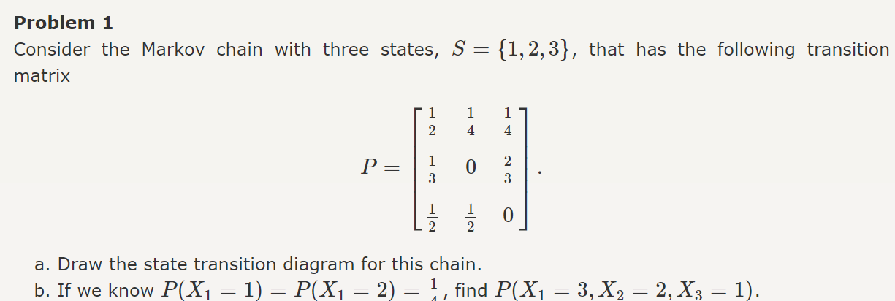
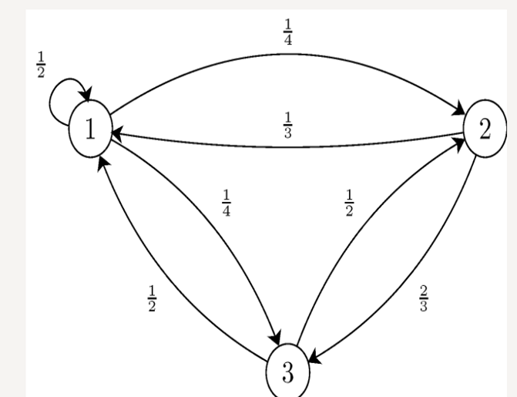
Example:

Slide 22
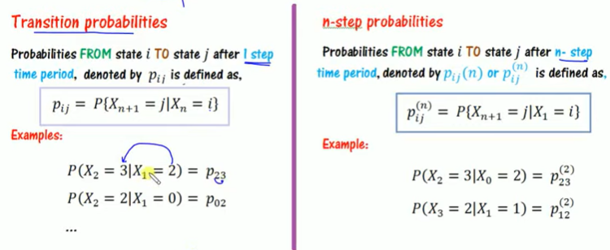
Transition probabilities

Slide 23
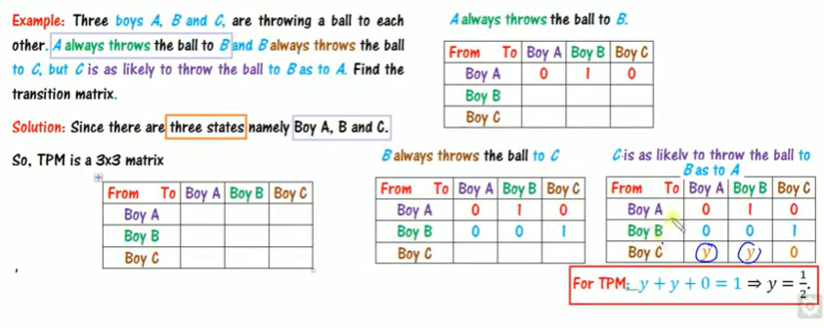
Example on Transition probability matrix

Slide 24
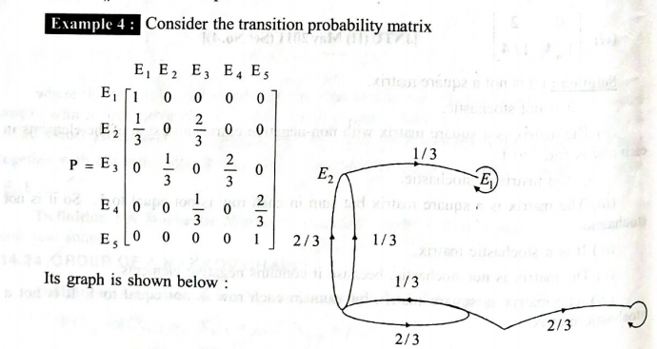
Example 1 Draw a transition diagram for given transition probability matrix

Slide 25
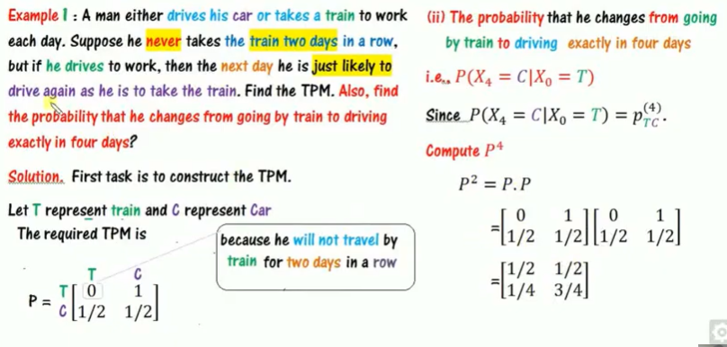
Example:

Slide 26
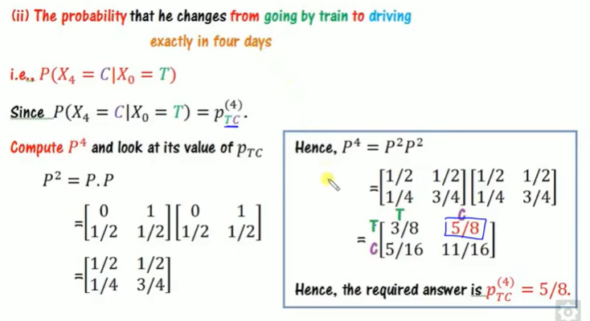

Slide 27
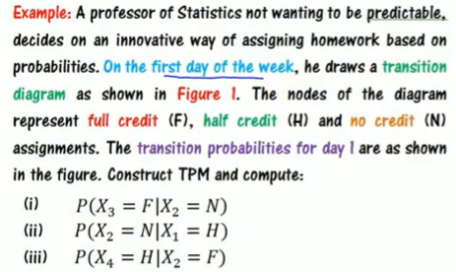
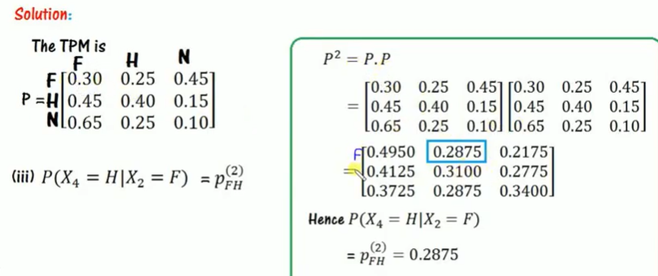
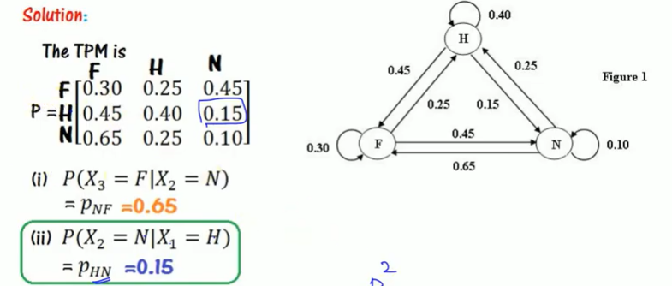
Example:

Slide 28
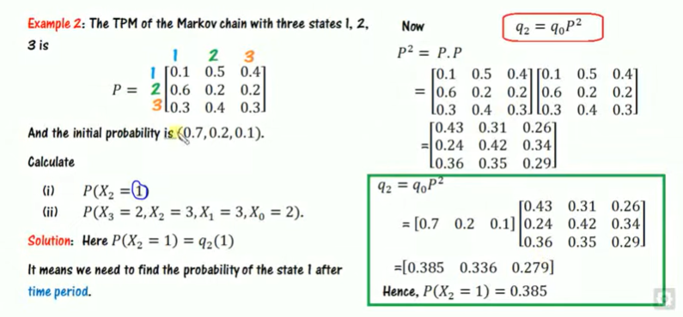
Example

Slide 29
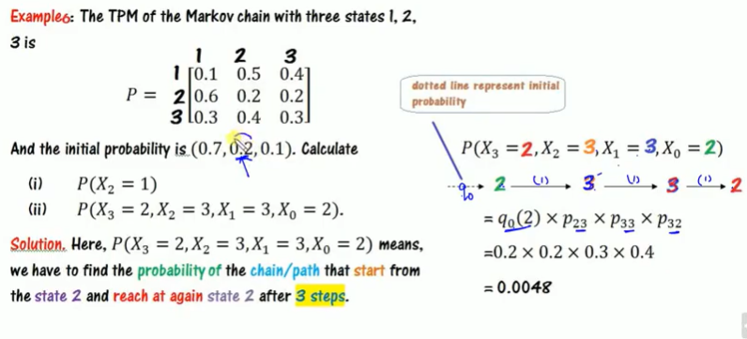
Examples on Markov chain

Slide 30
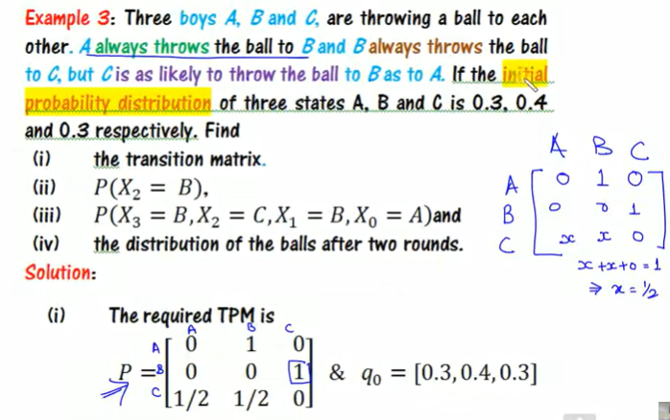
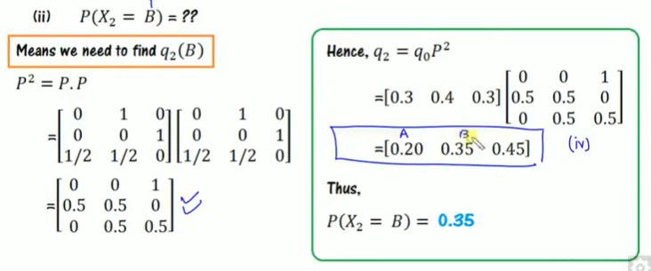
Example:

Slide 31
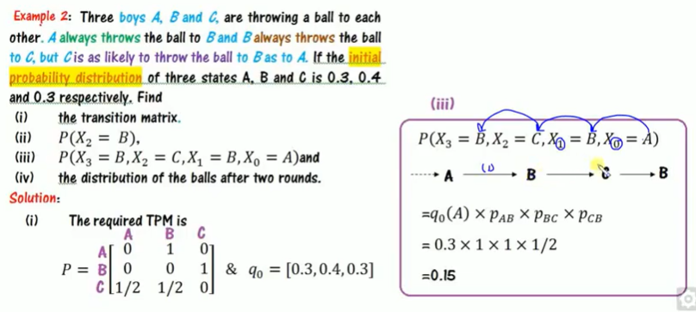
Example on Markov chain

Slide 32
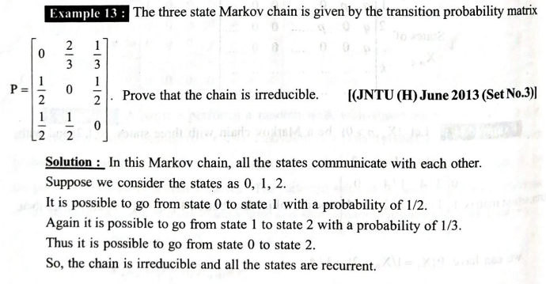
Example

Slide 33
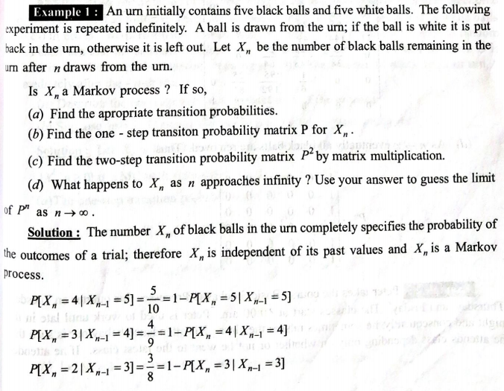
Example

Slide 34
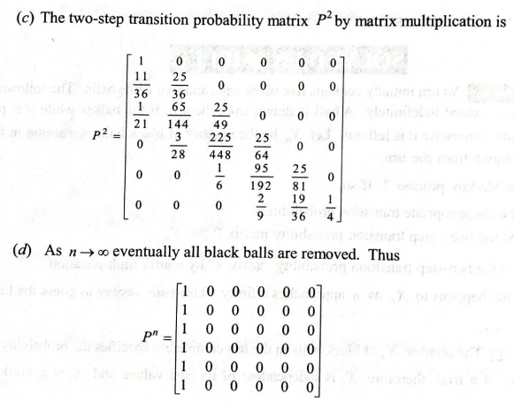
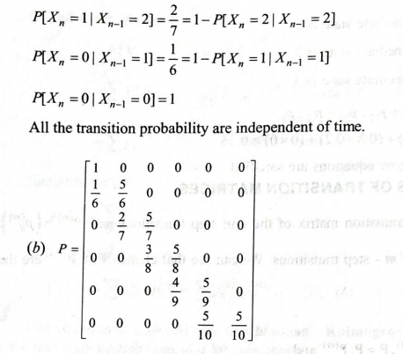

Slide 35
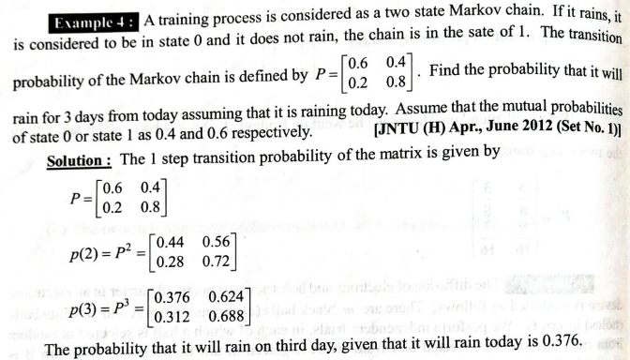
Example

Slide 36
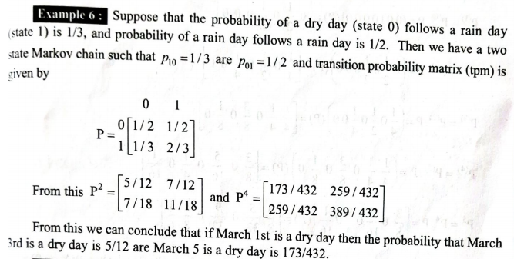
Example

Slide 37
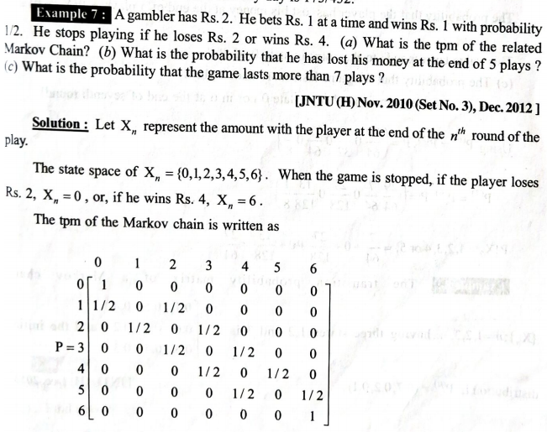
Example

Slide 38
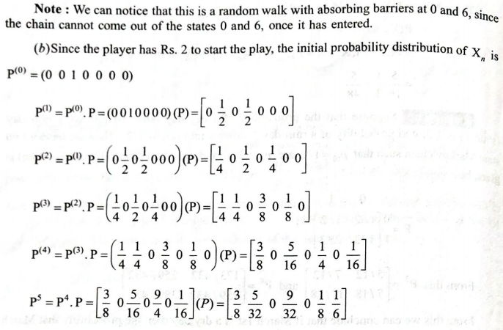
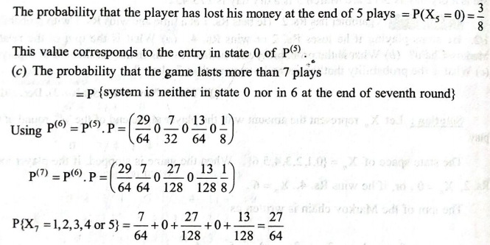

Slide 39
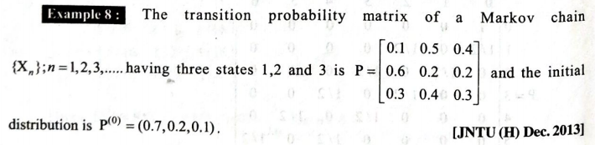
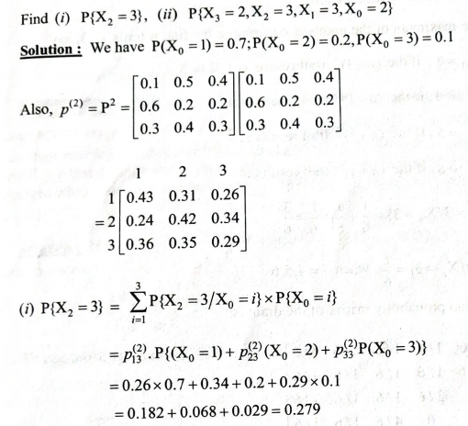
Example

Slide 40
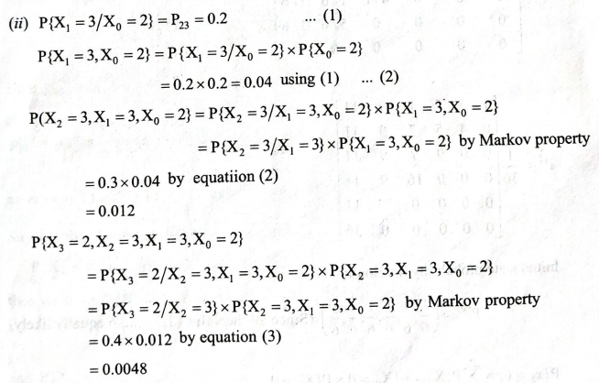

Slide 41
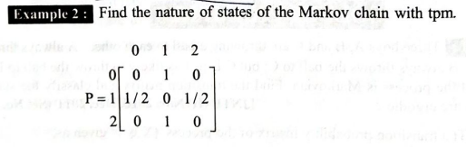

Example

Slide 42


Example

Slide 43


Example

Slide 44

Classification of states and Chains

Slide 45

Classification of states and chains contd--

Slide 46

Classification of states and chains cond…

Slide 47


Classification of Markov chain states

Slide 48

Applications of the Markov Processes

Slide 49
Limitations
08-10-2016
9
Customers do not always buy products in certain intervals and they do not always buy the same amount of a certain product.
Two or more brands may be bought at the same time
Customers always enter and leave markets, and therefore markets are never stable
The transition probabilities of a customer switching from an i brand to an j brand are
not constant for all customers
These transitional probabilities may change according to the average time between buying situations
The time between different buying situations may be a function of the last brand
bought.
The other areas of the marketing environment such as sales promotions, advertising, competition etc. were not included in these models.

Slide 50
MARKOV CHAIN ANALYSIS APPLIED TO MARKETING
10
08-10-2016
Examples
FMCG Product- Biscuits
Airlines
Personal Care Product – Razors

Slide 51
Markov Chain Analysis Applied To FMCG Product-
Biscuits
08-10-2016
11
Q) Suppose that there are three brands of Biscuits namely Good Day, Monaco, Marie selling in a market. The market has been observed continuously month after month for changes in the brand loyalty – that is to say, whether and how customers change their brand of biscuits over time. Let us say that rate of brand switching has settled over time as follows: Every month customers are being drawn from brand Good Day to Monaco to the extent of 30%, 10% drawn to Marie and the remaining 60% staying with Good Day itself. However, 20% of those eating Monaco in a given month are drawn to Good Day; one-half of them do not change the brand and uses this same brand in the next month as well, while the remaining 30% shift to Marie. Similarly the behaviour with regard to Marie is found to be like this- 80% of the customers stick to Marie, 15% shift to Good Day, while remaining 5% shift to Monaco, each month.

Slide 52
Question Cont’d
08-10-2016
12
Given these conditions about brand switching, assuming no further entry or exit and given further that the market share for these three brands for the Month March is 30%,45%,25% for Good Day, Monaco, Marie respectively. Determine :
What would be the market share of these three brands after 2 months (Short Run)?
What would be the market share of these three brands in the Long Run?

Slide 53
Solution
08-10-2016
13
Brand Month(March)
Brand Next Month(April)
0.60
Good Day
Good Day
0.30
0.10
0.20
Monaco
0.50
Monaco
0.30
0.15
Marie
0.05
Marie
0.80

Slide 54

Solution Cont’d
Input
Transition Probabilities
(Row- Indicates the retention and loss of market share to other brands Column- Indicates retention and
gain of market )
Initial Conditions
(Describes the current situation)
Output
Specific State Probabilities (Short Run)
Steady State Probabilities (Long Run)

Slide 55
Input : Transition Probability Matrix
08-10-2016
15
From Brand (Month - March) | To Brand (April)
 | Good Day | Monaco | Marie
Good Day | 0.60 | 0.30 | 0.10
Monaco | 0.20 | 0.50 | 0.30
Marie | 0.15 | 0.05 | 0.80
Alternately,
Good Day MonacoMarie
 | 0.60 | 0.30 | 0.10
P = | 0.20 | 0.50 | 0.30
 | 0.15 | 0.05 | 0.80
Sum of the probabilities = 1

Slide 56
Input : Initial Condition
08-10-2016
16
As the market is divided 30%, 45%, 25% between the brands Good Day, Monaco, Marie on the current month i.e. March, - Initial condition
Hence Row vector expressed as,
0.30 0.45 0.25

Slide 57
Output : Specific State Probabilities (Short Run)
08-10-2016
17
Let q_{D1} (0) = Probability of customer choosing Brand Good Day this month i.e. in March
q_{D1} (1) = Probability of customer choosing Brand Good Day after one transition i.e. in April q_{D1} (2) = Probability of customer choosing Brand Good Day after two transition i.e. in May
Hence the probability distribution of the customer choosing any given brand (Good Day, Monaco, Marie ) in any given month (k) Iis expressed as follows:
Q(k)= q_{D1} (k) q_{D2} (k) q_{D3} (k)
Initial Condition is expressed as Q(0) Q(0)= 0.30 0.45 0.25
Hence Market Share of each 3 brands in the month April will be Q(1)
Q(1)= 0.30 0.45 0.25 * 0.60
0.30 0.10
0.20 0.50 0.30
0.15 0.05 0.80
Q(1) = 0.3075
0.3275 0.3650

Slide 58
Solution Cont’d
08-10-2016
18
In general terms
Q(1) = q₁(1) q₂(1) q₃(1)……..q_{n}(1) Q(2)= Q(0)P * P = Q(0)P²
= Q(0)P
Therefore market Share of three Biscuits after two months i.e. in May = Q(2)
0.60 | 0.30 | 0.10 |  | 0.60 | 0.30 | 0.10
0.20 | 0.50 | 0.30 | * | 0.20 | 0.50 | 0.30
0.15 | 0.05 | 0.80 |  | 0.15 | 0.05 | 0.80
_{P}2 =

Slide 59
Solution Cont’d
08-10-2016
19
 | 0.0435 | 0.335 | 0.230
P² = | 0.265 | 0.325 | 0.410
 | 0.220 | 0.110 | 0.670
Now Q(2) = Q(0)P²
 |  |  |  |  | 0.0435 | 0.335 | 0.230
Q(2) = | 0.30 | 0.45 | 0.25 |  | 0.265 | 0.325 | 0.410
 |  |  |  |  | 0.220 | 0.110 | 0.670
Q(2) = 0.30475 0.27425 0.42100
The Market Share of 3 brands of biscuits Good Day, Monaco, Marie are expected to be 30.475%, 27.425%, 42.10% respectively after two months.

Slide 60
Output : Steady State Probabilities (Long Run)
08-10-2016
20
Calculation of steady state probabilities q1= 0.60q1+0.20q2+0.15q3 …………(1) q2=0.30q1+0.50q2+0.05q3…………..(2) q3=0.10q1+0.30q2+0.80q3…………..(3)
As q1+q2+q3 = 1………………………………..(4)
Considering Eq. 1, 2 and 4 and putting in matrix form
0.60 | -0.20 | -0.15 |  | q1 |  | 0
-0.30 | 0.50 | -0.05 |  | q2 | = | 0
1 | 1 | 1 |  | q3 |  | 1

Slide 61
Solution Cont’d
08-10-2016
21
Applying Cramer’s Rule to the matrix
∆= 0.290
∆1 = 0.085
∆2= 0.065
∆3= 0.140
Accordingly, q1 = ∆1 / ∆ = 0.085/0.290 = 0.293 q2 = ∆2 / ∆ = 0.065/0.290 = 0.224
q3 = ∆3 / ∆ = 0.14/0.290 = 0.483
Thus if the given transition probabilities remain constant over time (Long Run), the market share of the brands shall be 29.3%, 22.4%,48.3% respectively.

Slide 62
Markov Chain Analysis Applied To Airlines
08-10-2016
22
In analysing switching by Business Class customers between airlines the following data has been obtained by British Airways (BA):
 |  | Next flight by
 |  | BA | Competition
Last flight by | BA | 0.85 | 0.15
 | Competition | 0.10 | 0.90
Business Class customers make 2 flights a year on average.
Currently BA have 30% of the Business Class market. What would you
forecast BA's share of the Business Class market to be after two years?

Slide 63
Solution
08-10-2016
23
We have the initial system state s₁ given by s₁ = [0.30, 0.70] and the transition matrix P is given by
0.85 0.15
P =
0.10 0.90
as Business Class customers make 2 flights a year on average.
P = 0.85
0.15 0.85 0.15 0.7375
* =
0.90 0.10 0.90 0.1750
0.2625
0.10
0.8250

Slide 64
Solution
08-10-2016
24
Hence after one year has elapsed the state of the system
s₂ = s₁P | [0.30, 0.70] * | 0.7375 | 0.2625
 |  | 0.1750 | 0.8250
= [0.34375, 0.65625]

Slide 65
Solution
08-10-2016
25
After two years
s₃ = s₂P = [0.368, 0.632]
So after two years have elapsed BA's share of the Business Class market is 36.8%

Slide 66
Markov Chain Analysis Applied To Personal Care Product - Razors
08-10-2016
26
Suppose that new razor blades were introduced in the market by three companies at the same time. When they were introduced , each company had an equal share of the market, but during the first year the following changes took place:
Gillette retained 90 percent of its customers, lost 3 percent to Phillips and 7 percent to Braun
Phillips retained 70 percent of its customers, lost 10 percent to Gillette and 20 percent to Braun
Braun retained 80 percent of its customers, lost 10 percent to Gillette and 10 percent to Phillips

Slide 67
08-10-2016
27
Suppose that no changes in buying habits of the consumer occur.
What are the market shares of three companies at the end of the first year and second year?
What are the long-run market share of three companies?

Slide 68
Solution
08-10-2016
28
Brand First Year
Brand Second Year
0.90
Gillette
Gillette
0.03
Good Day
0.07
0.10
Phillips
0.70
Phillips
Monaco
0.20
0.10
Braun
0.10
Braun
Marie
0.80

Slide 69
Input : Transition Probability Matrix
08-10-2016
29
From Brand (First Year) | To Brand (Second Year)
 | Gillette | Phillips | Braun
Gillette | 0.90 | 0.03 | 0.07
Phillips | 0.10 | 0.70 | 0.20
Braun | 0.10 | 0.10 | 0.80
Alternately,
Gillette Phillips Braun
 | 0.90 | 0.03 | 0.07
P = | 0.10 | 0.70 | 0.20
 | 0.10 | 0.10 | 0.80
Sum of the probabilities = 1

Slide 70
Input : Initial Condition
08-10-2016
30
As the market is divided equally between the brands Gillette, Phillips and Braun in the first year - Initial condition
Hence Row vector expressed as,
0.33 0.33 0.33

Slide 71
Output : Specific State Probabilities (Short Run)
08-10-2016
31
Let q_{D1} (0) = Probability of customer choosing Brand Gillette first year
q_{D1} (1) = Probability of customer choosing Brand Gillette after one transition
q_{D1} (2) = Probability of customer choosing Brand Gillette after two transition
Hence the probability distribution of the customer choosing any given brand (Gillette, Phillips and Braun) in any given year (k) is expressed as follows:
Q(k)= q_{D1} (k) q_{D2} (k) q_{D3} (k)
Initial Condition is expressed as Q(0)
Q(0)= 0.33 0.33 0.33
Hence Market Share of each 3 brands at the end of one year will be Q(1)
Q(1)= | 0.33 | 0.33 | 0.33 * | 0.90 | 0.03 | 0.07
 |  |  |  | 0.10 | 0.70 | 0.20
 |  |  |  | 0.10 | 0.10 | 0.80
Q(1) = 0.367
0.277 0.356

Slide 72
Solution Cont’d
08-10-2016
32
In general terms
Q(1) = q₁(1) q₂(1) q₃(1)……..q_{n}(1)
Q(2)= Q(0)P * P = Q(0)P²
= Q(0)P
Therefore market Share of three razors after two years= Q(2)
0.90 | 0.03 | 0.07 |  | 0.90 | 0.03 | 0.07
0.10 | 0.70 | 0.20 | * | 0.10 | 0.70 | 0.20
0.10 | 0.10 | 0.80 |  | 0.10 | 0.10 | 0.80
_{P}2 =

Slide 73
Solution Cont’d
08-10-2016
33
Now Q(2) = Q(0)P²
Q(2) = 0.3933 0.2403 0.3664
The Market Share of 3 brands of razors Gillette, Phillips and Braun are expected to be 39.3
%, 24.03 %, 36.64 % respectively after two years.

Slide 74
Output : Steady State Probabilities (Long Run)
08-10-2016
34
Calculation of steady state probabilities q1= 0.90q1+0.10q2+0.10q3 …………(1) q2=0.03q1+0.70q2+0.10q3…………..(2) q3=0.07q1+0.20q2+0.80q3…………..(3)
As q1+q2+q3 = 1………………………………..(4) Considering Eq. 1, 2 and 4 and putting in matrix form
0.10 | -0.10 | -0.10 |  | q1 |  | 0
-0.03 | 0.30 | -0.10 |  | q2 | = | 0
1.00 | 1.00 | 1.00 |  | q3 |  | 1

Slide 75
Solution Cont’d
08-10-2016
35
Applying Cramer’s Rule to the matrix
∆= 0.080
∆1 = 0.040
∆2= 0.013
∆3= 0.027
Accordingly, q1 = ∆1 / ∆ = 0.040/0.080 = 0.50 q2 = ∆2 / ∆ = 0.013/0.080= 0.16
q3 = ∆3 / ∆ = 0.027/0.080 = 0.34
Thus if the given transition probabilities remain constant over time (Long Run), the market share of the brands shall be 50 %, 16 %, 34 % respectively.

